Slide 1

Submitted by
Team Details
Team ID: LTVIP2025TMID29467
Team Size: 4 Members
Team Members
Team Leader: Sasikumar Pitta
Team Member: Nakka Baba Sai
Team Member: Pasupuleti Leela Satya Charan
Team Member: Ganji Gangadhar
From the Aditya college of Engineering and Technology

Slide 2

Eco Tips: Empowering Sustainable Living with IBM
Granite LLM
An AI-powered assistant for actionable environmental advice, leveraging IBM Granite LLM for personalised eco-guidance. Bridging the gap between awareness and action in smart cities.

Slide 3
The Growing Environmental Literacy Gap
Uncertainty
65% of UK adults unsure how to significantly reduce carbon footprint.
Waste Increase
UK household waste up 12% in 2022 vs. 2019.
Youth Engagement
Youth environmental engagement often
lacks actionable steps.
Recycling Errors
Only 38% of UK citizens consistently recycle correctly.

Slide 4

Introducing the "Eco Tips" Assistant
An interactive AI tool offering practical sustainability tips. Designed for easy use by students, educators, and citizens, it converts general environmental concepts into specific, actionable guidance. Accessible via school networks and future city platforms.
Interactive AI Tool
Easy for All Users
Actionable Guidance

Slide 5
Powering the Intelligence: IBM Granite LLM
Enterprise-Grade AI
IBM Granite: A robust foundation model for trusted AI applications.
Ethical & Private
Strong focus on data privacy and responsible AI development.
Factually Accurate
Trained on vast datasets, ensuring reliable, context- specific recommendations.
Configurable
Adaptable for specific city sustainability priorities and challenges.

Slide 6

Impact in Action: A School Environmental Session
1 Plastic Wisdom
Students input "plastic": "Refuse single-use plastics; carry reusable water bottles, saving 150 bottles yearly."
2
Energy Savings
Students input "energy": "Unplug chargers; save £30 annually per household."
Food Waste Reduction
Students input "food waste": "Plan meals to reduce food waste by 25% monthly."
Confidence Boost
90% of students reported increased confidence in eco- actions.

Slide 7
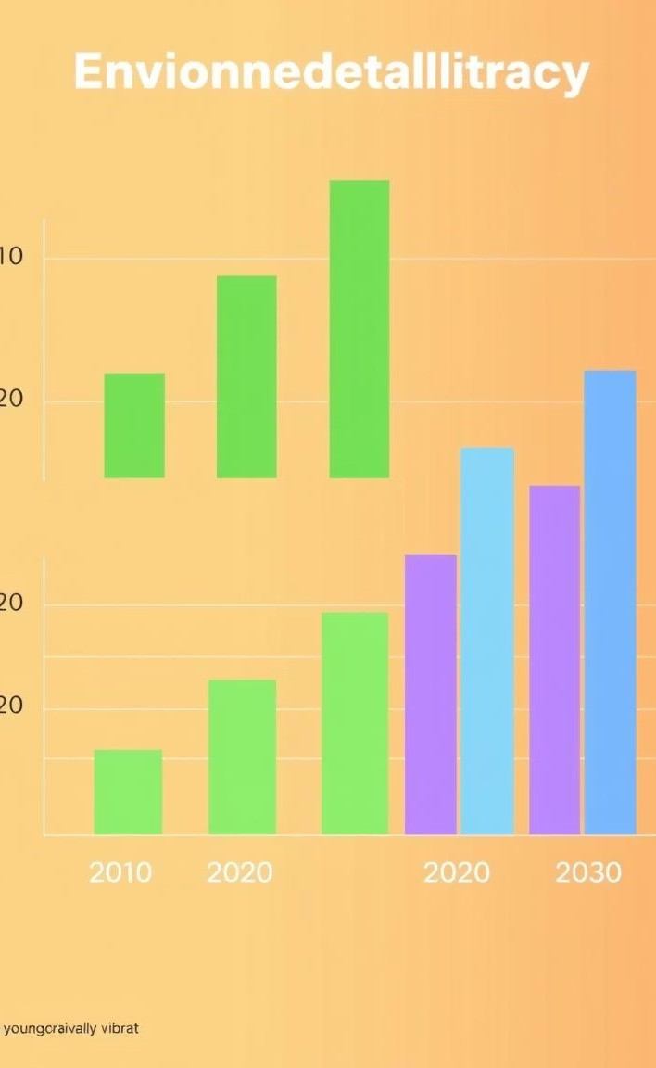
Measurable Benefits & Outcomes
20%
Literacy Boost
Increase in student environmental understanding scores.
15%
Plastic Reduction
Reduction in school canteen single-use plastic waste.
Net-&
Policy Alignment
Supports UK's net-zero targets and local sustainability goals.
Active
Citizenship
Promotes active environmental stewardship.

Slide 8
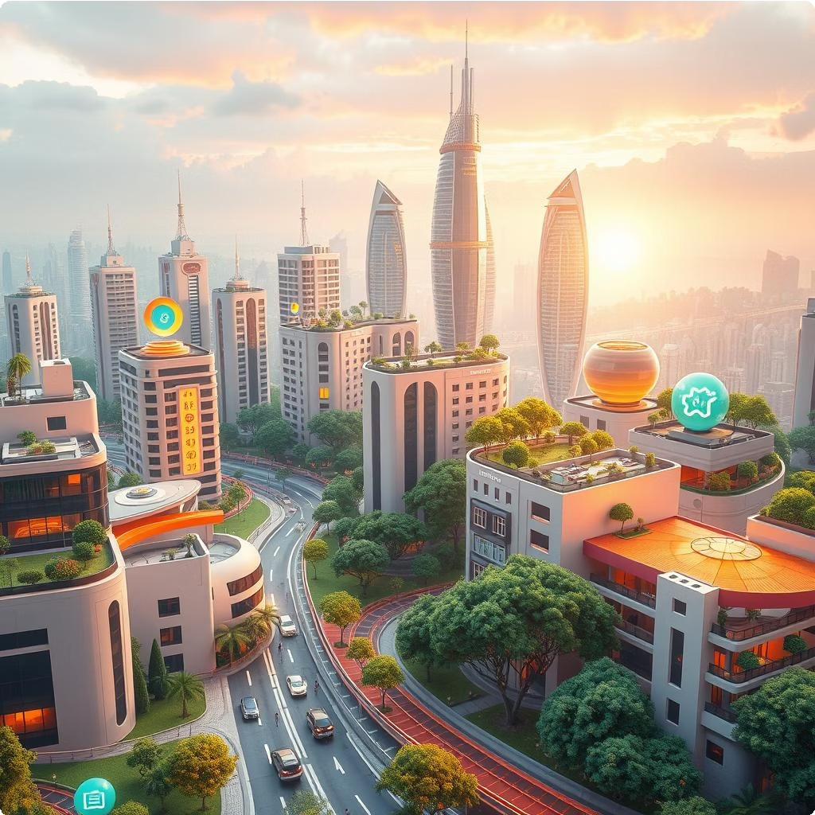
Scaling for a Smarter, Greener City
Expand Eco Tips into public digital platforms and libraries. Personalised eco-challenges via smart home integrations. Link to real-time city data for energy grid and waste. Develop community-specific tips for local challenges. Potential for gamified learning and reward systems.
Public Platforms
Integrate into city's digital services.
Smart Homes
Personalised eco-challenges.
Real-Time Data
Link to city energy and waste.
Gamification
Engaging learning and rewards.

Slide 9
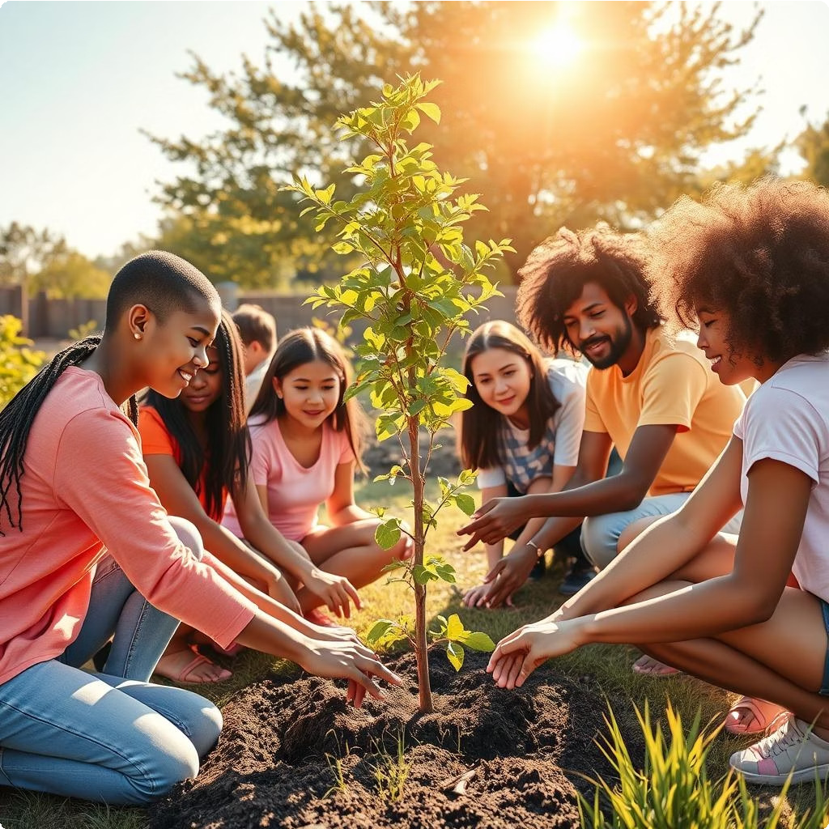
Conclusion: Empowering a Sustainable Future
AI + Education
Drives actionable environmental change.
IBM Granite
Provides reliable, relevant eco-guidance.
Proactive Citizens
Fostering an eco-conscious generation.
Smarter Communities
Building sustainable cities together.

Slide 10

Thank You
For more information on the Eco Tips assistant and IBM Granite LLM.

